Slide 1

Simple Comparative Experiments
MECE 5397/6397
Hybrid Approach
Introduction of Design of Experiments with Machine Learning
Session #2.1
Statistical concepts
4 to 6pm
Instructor: Egidio (Ed) Marotta, PhD

Slide 2
Simple Comparative Experiments: Concepts & Ideas
Objectives:
Basic statistical concepts such as
1) random sampling,
2) probability distributions,
3) sample distributions,
4) and test of hypotheses
Two-sample t-test, and use it to compare difference in two means
Confidence intervals to express the difference in means
Check assumption for the t-test

Slide 3
Simple Comparative Experiments: Concepts & Ideas
Key Concepts and Ideas
1) Treatment
2) Factor level
3) Statistical hypothesis testing
4) Confidence interval
5) P– value
6) Normal distribution
7) Chi-square distribution
8) t-distribution
9) F-distribution
10) Randomized experiments
11) Statistical model

Slide 4
Simple Comparative Experiments: Concepts & Ideas
Introduction
We consider experiments to compare two conditions (sometimes called treatments). These are often called simple comparative experiments.
We’ll begin with an example of an experiment performed to determine whether two different formulations of a product give equivalent results.
The discussion leads to a review of several basic statistical concepts, such as 1) ⁺⁺random variables, 2) probability distributions, 3) random samples, 4)sampling distributions, and 5) tests of hypotheses.
⁺⁺A random variable is a variable where chance determines its value. They can take on either discrete or continuous values, and understanding the properties of each type is essential.
Example Experiment:
An engineer is studying the formulation of a Portland cement mortar. He has added a polymer latex emulsion during mixing to determine if this impacts the curing time and tension bond strength of the mortar. The experimenter prepared 10 samples of the original formulation and 10 samples of the modified formulation. We will refer to the two different formulations as two treatments or as two levels of the factor formulations.

Slide 5
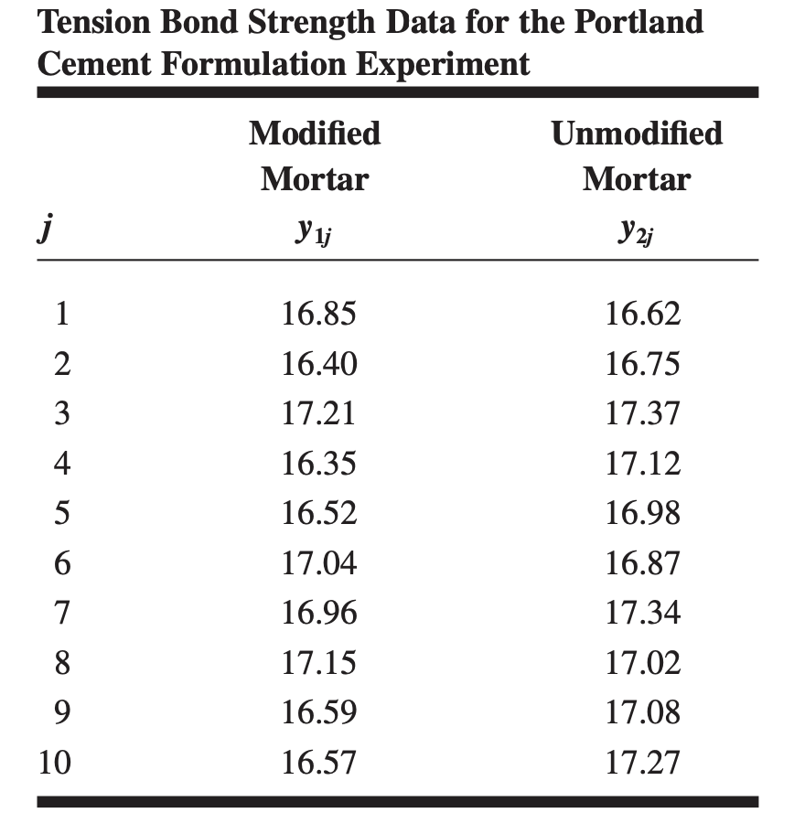
Simple Comparative Experiments: Concepts & Ideas

Slide 6
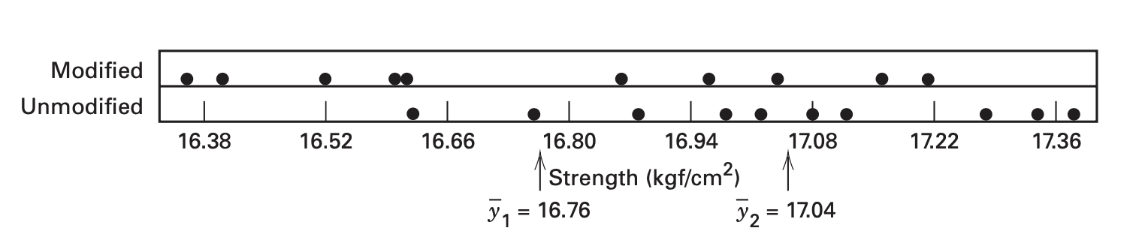
The tension bond strength data from this experiment are shown in the prior table and plotted in the figure above. The graph is called a dot diagram.
Visual examination of these data gives the impression that the strength of the unmodified mortar may be greater than the strength of the modified mortar.
Simple Comparative Experiments: Concepts & Ideas
The average tension bond strengths in these two samples differ by what seems to be a modest amount. However, it is not obvious that this difference is large enough to imply that the two formulations really are different. Perhaps this observed difference in average strengths is the result of sampling fluctuation and the two formulations are really identical.

Slide 7
Simple Comparative Experiments: Concepts & Ideas
General Observations
Each of the observations in the Portland cement experiment described above would be called a run. Notice that the individual runs differ, so there is fluctuation, or noise, in the observed bond strengths. This noise is usually called experimental error or simply error. It is a statistical error, meaning that it arises from variation that is uncontrolled and generally unavoidable.
Graphical Description of Variability
We often use simple graphical methods to assist in analyzing the data from an experiment. The dot diagram, illustrated in the figure, is a very useful device for displaying a small body of data (say up to about 20 observations). The dot diagram enables the experimenter to see quickly the general location or central tendency of the observations and their spread or variability
If the data are fairly numerous, the dots in a dot diagram become difficult to distinguish and a histogram may be preferable. The figure on the next slide presents a histogram for 200 observations on the metal recovery, or yield, from a smelting process. The histogram shows the central tendency, spread, and general shape of the distribution of the data.

Slide 8
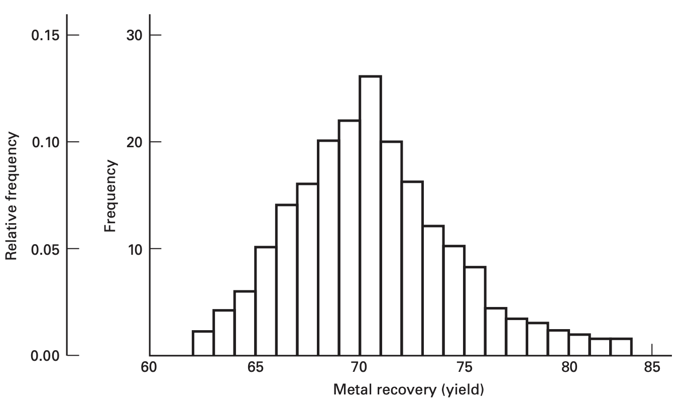
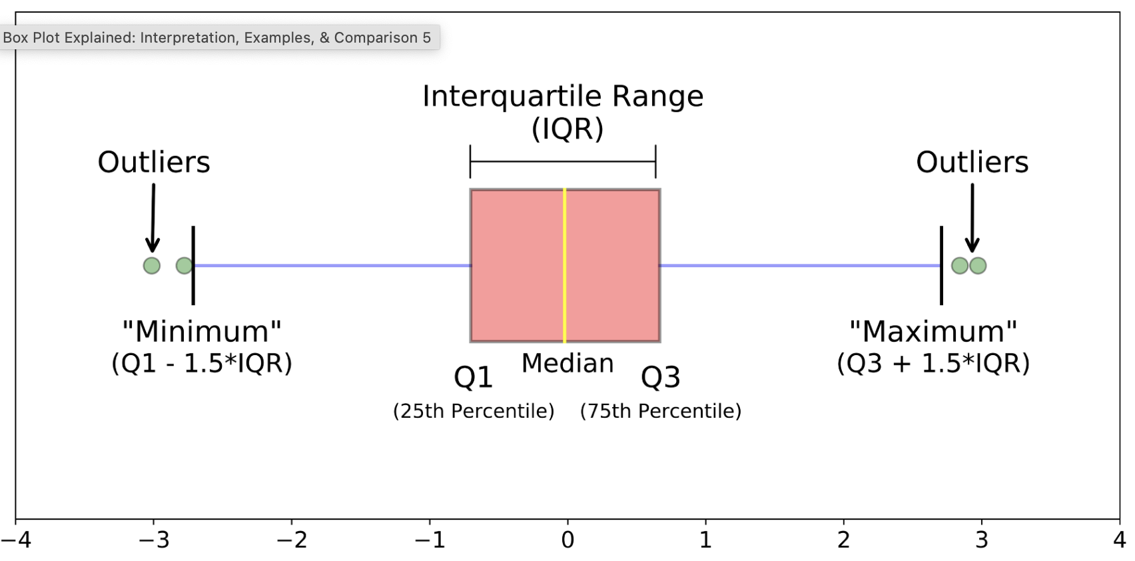
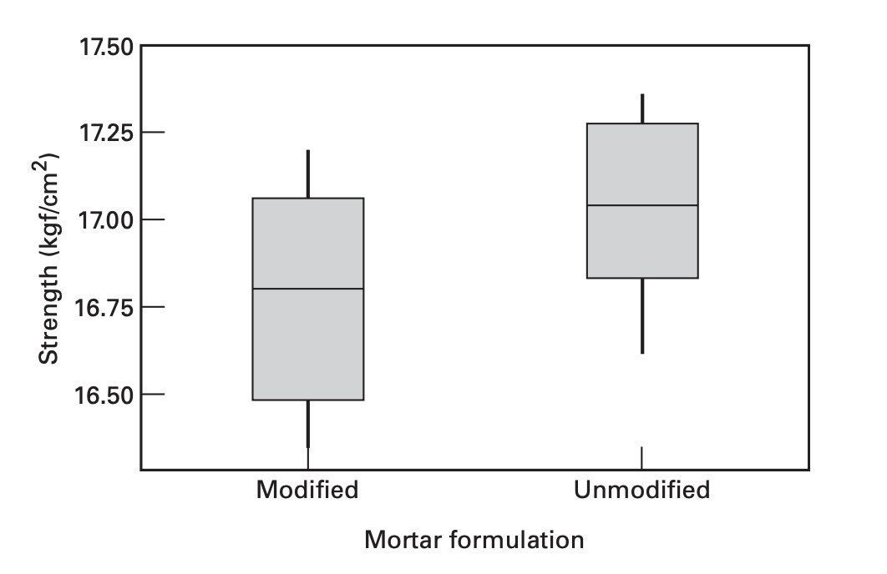
Simple Comparative Experiments: Concepts & Ideas
The histogram shows the central tendency, spread, and general shape of the distribution of the data. Recall that a histogram is constructed by dividing the horizontal axis into bins (usually of equal length) and drawing a rectangle over the jth bin with the area of the rectangle proportional to n_{j} , the number of observations that fall in that bin.
Histogram
Boxplot
The box plot (or box-and-whisker plot) is a very useful way to display data. A box plot displays the minimum, the maximum, the lower and upper quartiles (the 25th percentile and the 75th percentile, respectively), and the median (the 50th percentile) on a rectangular box aligned either horizontally or vertically.
https://www.simplypsychology.org/boxplots.html

Slide 9
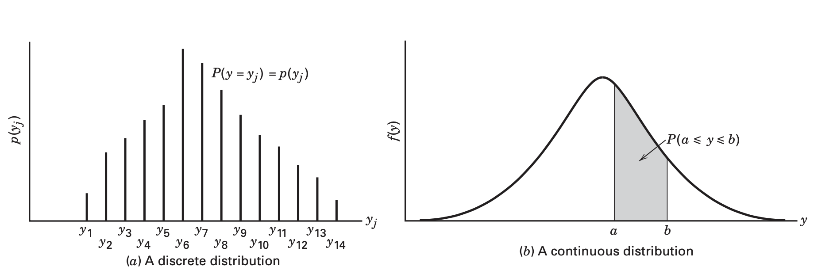
Simple Comparative Experiments: Concepts & Ideas
Probability Distributions. The probability structure of a random variable, say y, is described by its probability distribution. If y is discrete, we often call the probability distribution of y, say p(y), the probability mass function of y. If y is continuous, the probability distribution of y, say f(y), is often called the probability density function for y.
The figs illustrate hypothetical discrete and continuous probability distributions. Notice that in the discrete probability distribution, it is the height of the function p(y_{j}) that represents probability,
Whereas in the continuous case it is the area under the curve f(y) associated with a given interval that represents probability.

Slide 10
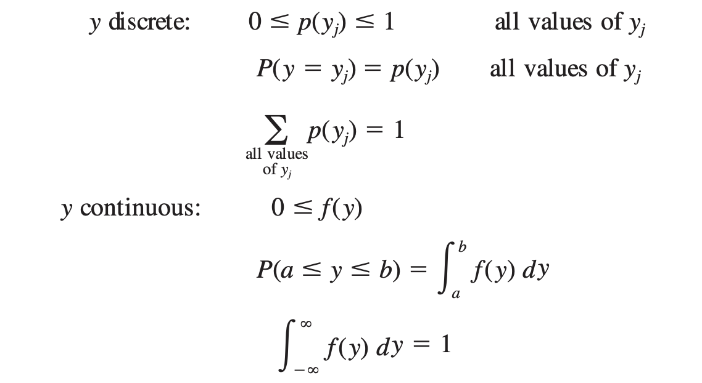
Simple Comparative Experiments: Concepts & Ideas
The properties of probability distributions may be summarized quantitatively as follows:

Slide 11
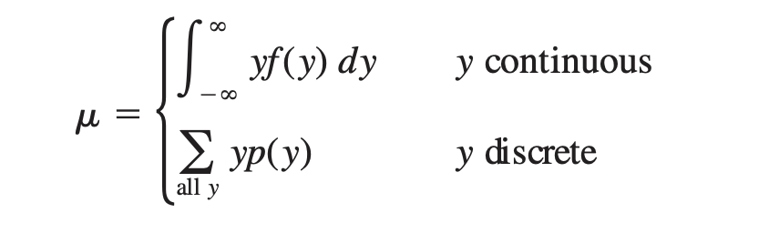
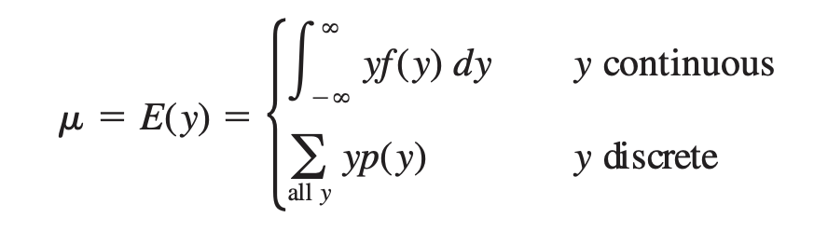
Simple Comparative Experiments: Concepts & Ideas
Mean, Variance, and Expected Values
The mean, 𝞵, of a probability distribution is a measure of its central tendency or location. Mathematically, we define the mean as
We also have the expected value or the long-run average value
The expected value is found by calculating the weighted value from the data, this represents what can be expected over many trials of the experiment.
E denotes the expected value operator

Slide 12
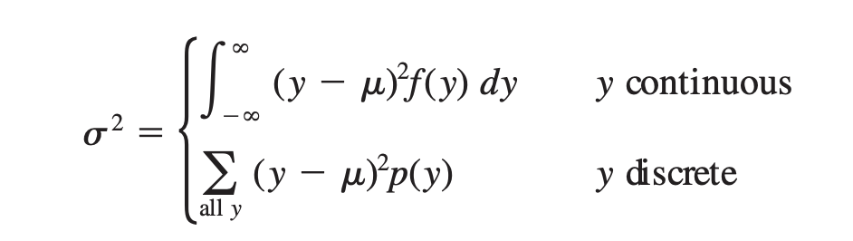
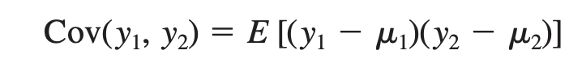
Simple Comparative Experiments: Concepts & Ideas
The variability or dispersion of a probability distribution can be measured by the variance
Covariance
The covariance is a measure of the linear association between y1 and y2. More specifically, we may show that if y1 and y2 are independent, then Cov(y1, y2) = 0.

Slide 13
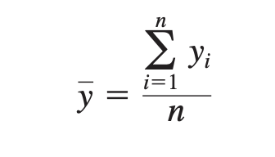
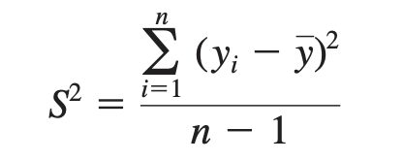
Simple Comparative Experiments: Concepts & Ideas
Random Samples
The objective of statistical inference is to draw conclusions about a population using a sample from that population. Most of the methods that we will study assume that random samples are used. A random sample is a sample that has been selected from the population in such a way that every possible sample has an equal probability of being selected.
The sample mean
The sample variance
Sometimes S = sqr(S²), called the sample standard deviation, is used as a measure of dispersion. Experimenters often prefer to use the standard deviation to measure dispersion because its units are the same as those for the variable of interest y.

Slide 14
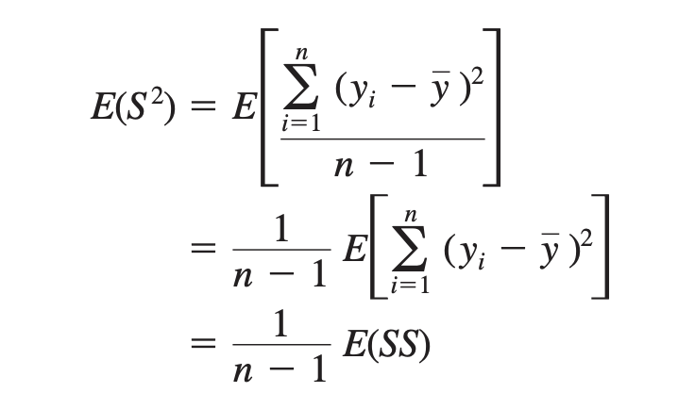
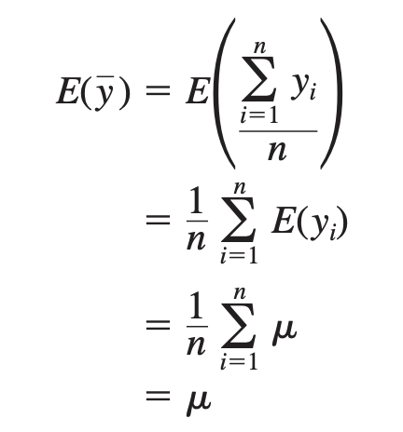
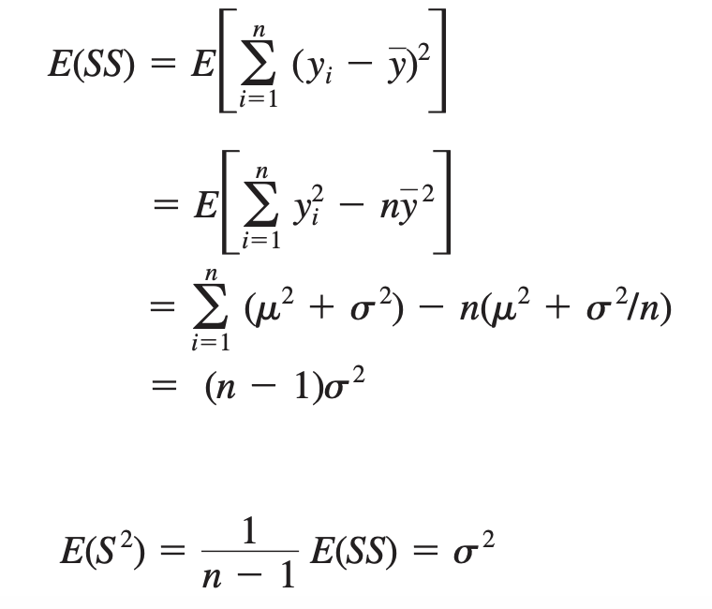
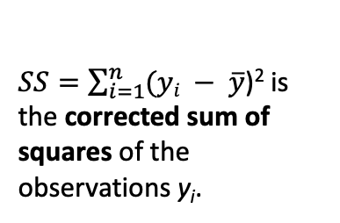
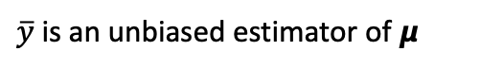
Simple Comparative Experiments: Concepts & Ideas
Properties
The sample mean y is a point estimator of the population mean 𝞵, and the sample variance S² is a point estimator of the population variance 𝞼². In general, an estimator of an unknown parameter is a statistic that corresponds to that parameter.
Proof
Proof
$SS=\sum_{i=1}^{n}{(yi − \overline{y}}$)² is the corrected sum of squares of the observations y_{i}.
$\overline{y}$is an unbiased estimator of 𝞵
S² is an unbiased estimator of 𝞼².
Notes:
S2 is an unbiased estimator of !2.

Slide 15
Simple Comparative Experiments: Concepts & Ideas
Degrees of Freedom
The quantity n - 1 in the Estimator Sample Variance is called the number of degrees of freedom of the sum of squares SS.
The number of degrees of freedom of a sum of squares is equal to the number of independent elements in that sum of squares.
Degrees of Freedom Formula
The degrees of freedom formula is straightforward. Calculating the degrees of freedom is often the sample size minus the number of parameters (e.g., mean) you’re estimating:
DF = N – P
For example, the degrees of freedom formula for a 1-sample t test equals N – 1 because you’re estimating one parameter, the mean. To calculate degrees of freedom for a 2-sample t-test, use N – 2 because there are now two parameters to estimate.
Where:
N = sample size
P = the number of parameters or relationships
Notes:
S2 is an unbiased estimator of !2.

Slide 16
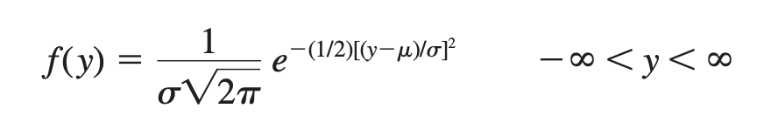
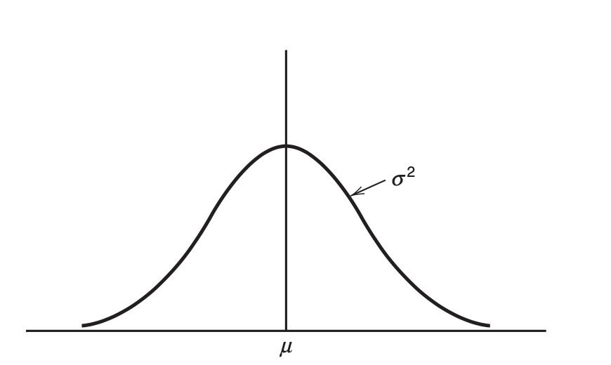
Simple Comparative Experiments: Concepts & Ideas
Normal Distributions
The Normal and Other Sampling Distributions
Often, we are able to determine the probability distribution of a particular statistic if we know the probability distribution of the population from which the sample was drawn. The probability distribution of a statistic is called a sampling distribution.
One of the most important sampling distributions is the normal distribution. If y is a normal random variable, the probability distribution of y is
where -∞ < 𝛍 < ∞ is the mean of the distribution and 𝛔² > 0 is the variance. The normal distribution.
Because sample runs that differ as a result of experimental error often are well described by the normal distribution, the normal plays a central role in the analysis of data from designed experiments.
Many important sampling distributions may also be defined in terms of normal random variables. We often use the notation y ~ N(𝜇, 𝜎²) to denote that y is distributed normally with mean 𝜇 and variance 𝜎².
Notes:
S2 is an unbiased estimator of !2.

Slide 17
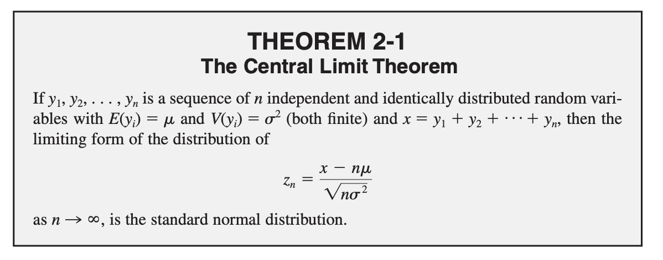
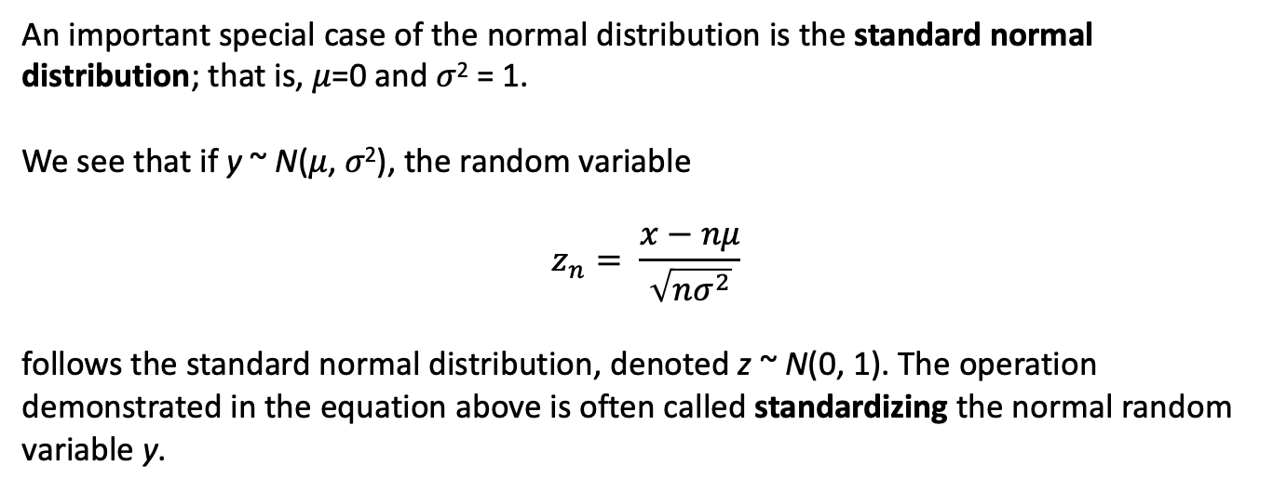
Simple Comparative Experiments: Concepts & Ideas
An important special case of the normal distribution is the standard normal distribution; that is, 𝜇=0 and 𝜎² = 1.
We see that if y ~ N(𝜇, 𝜎²), the random variable
$$z_{n}= \frac{x−nμ}{\sqrt{nσ^{2}}}$$
follows the standard normal distribution, denoted z ~ N(0, 1). The operation demonstrated in the equation above is often called standardizing the normal random variable y.
Notes:
S2 is an unbiased estimator of !2.

Slide 18
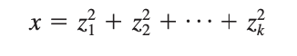
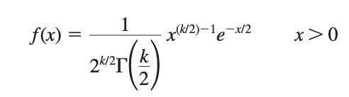
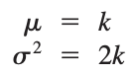
Simple Comparative Experiments: Concepts & Ideas
Sampling Distributions
An important sampling distribution that can be defined in terms of normal random variables is the chi-square or 𝜒2 distribution. If z1, z2, . . . , z_{k} are normally and independently distributed random variables with mean 0 and variance 1, abbreviated NID(0, 1), then the random variable x is,
follows the chi-square distribution with k degrees of freedom. The density function of chi-square is
The distribution is asymmetric, or skewed, with mean and variance
Notes:
S2 is an unbiased estimator of !2.

Slide 19
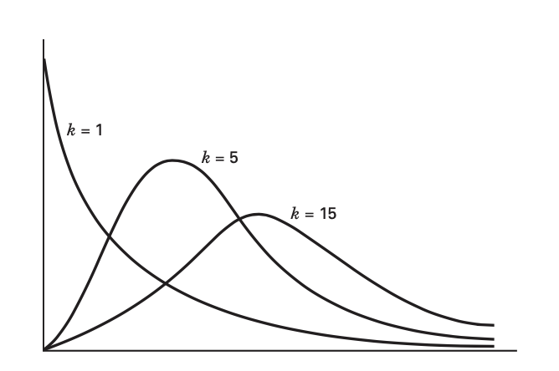

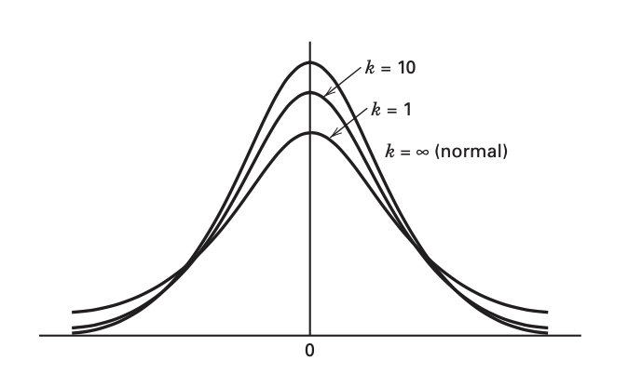
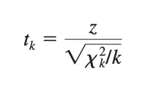
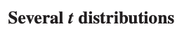
Sampling Distributions
Simple Comparative Experiments: Concepts & Ideas
Notes:
S2 is an unbiased estimator of !2.

Slide 20
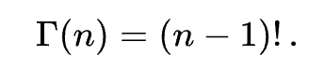
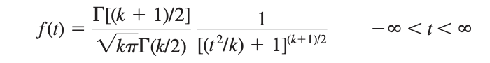
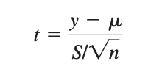
Simple Comparative Experiments: Concepts & Ideas
Sampling Distributions
t distribution with k degrees of freedom, denoted t_{k}
Gamma Function
The mean and variance of t are 𝜇 = 0 and 𝜎² = k/(k - 2) for k > 2, respectively.
If y1, y2, . . . , y_{n} is a random sample from the N(𝜇, 𝜎² ) distribution

Slide 21
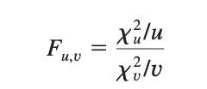
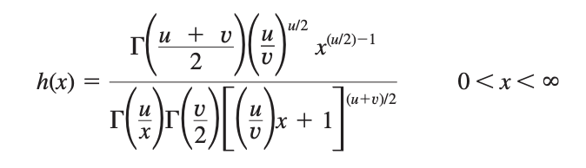
Simple Comparative Experiments: Concepts & Ideas
Sampling Distributions
The final sampling distribution that we will consider is the F distribution. If 𝜒²_{u} and 𝜒²_{v} are two independent chi-square random variables with u and v degrees of freedom, respectively, then the ratio
follows the F distribution with u numerator degrees of freedom and v denominator degrees of freedom.
If x is an F random variable with u numerator and v denominator degrees of freedom, then the probability distribution of x is

Slide 22
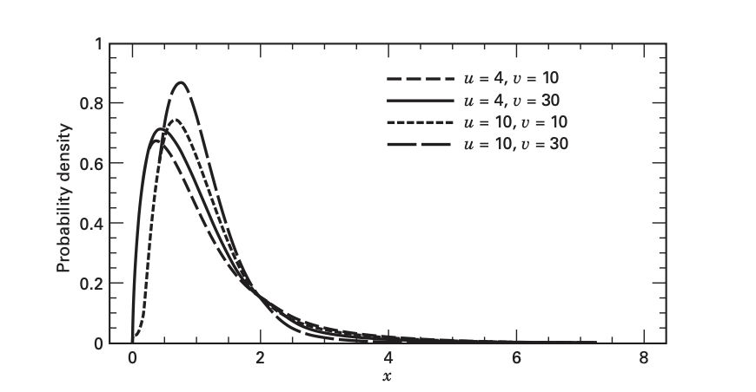
Simple Comparative Experiments: Concepts & Ideas
Sampling Distributions

Slide 23
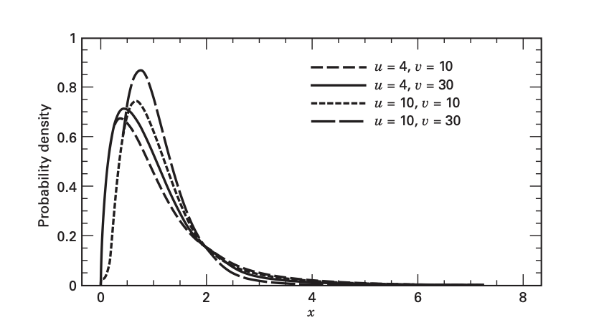
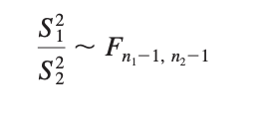
Simple Comparative Experiments: Concepts & Ideas
F Sampling Distributions
Ex.
As an example of a statistic that is distributed as F, suppose we have two independent normal populations with common variance 𝜎². If y₁₁, y₁₂, . . . , y_{1n1} is a random sample of n₁ observations from the first population, and if y₂₁, y₂₂, . . . , y_{2n2} is a random sample of n₂ observations from the second, then the ratios of the two-sample variances will follow the F distribution,
where S²₁ and S²₂ are the two sample variances

Slide 24
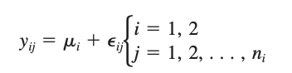
Simple Comparative Experiments: Concepts & Ideas
Inferences About the Differences in
Means, Randomized Designs: Hypothesis Testing
We are interested in comparing the strength of two different formulations: an unmodified mortar and a modified mortar. In general, we can think of these two formulations as two levels of the factor “formulations.”
A Model for the Data. We often describe the results of an experiment with a model. A simple statistical model that describes the data from an experiment such as the one just described is
where y_{ij} is the j^{th} observation from factor level i, 𝜇_{i} is the mean of the response at the i^{th} factor level, and 𝜖_{ij} is a normal random variable associated with the ij^{th} observation.
It is customary to refer to 𝜖_{ij} as the random error component of the model.

Slide 25
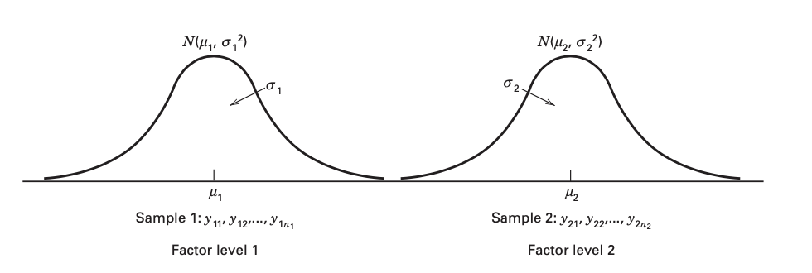
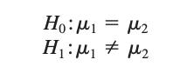
Simple Comparative Experiments: Concepts & Ideas
The sampling situation for the two-sample t-test
A statistical hypothesis is a statement either about the parameters of a probability distribution or the parameters of a model.
The statement H₀ : 𝜇1 = 𝜇2 is called the null hypothesis and H₁ : 𝜇1 ≠ 𝜇2 is called the alternative hypothesis. The alternative hypothesis specified here is called a two-sided alternative hypothesis because it would be true if 𝞵1 < 𝞵2 or if 𝞵1 > 𝞵2.

Slide 26
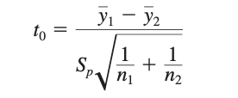
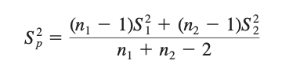
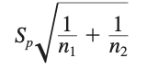
Simple Comparative Experiments: Concepts & Ideas
The Two-Sample t-Test. Suppose that we could assume that the variances of tension bond strengths were identical for both mortar formulations.
(Eq. 1)
where y₁ and y₂ are the sample means, n₁ and n₂ are the sample sizes, S²_{p} is an estimate of the common variance 𝞼²₁ = 𝞼²₂ = 𝞼² computed from Eq. 1.
S²₁ S²₂ are the two individual sample variances.
often called the standard error of the difference in means

Slide 27
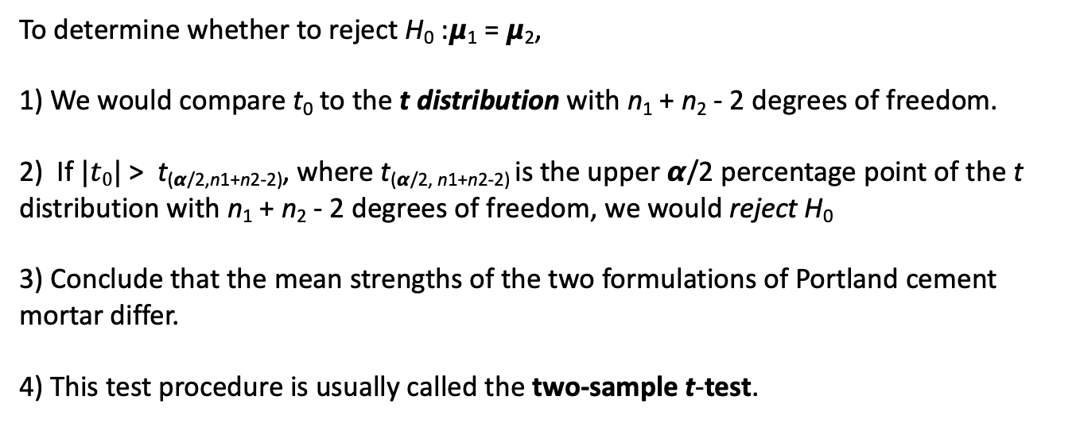
Simple Comparative Experiments: Concepts & Ideas
The Two-Sample t-Test. Procedure
To determine whether to reject H₀ :𝞵₁ = 𝞵₂,
1) We would compare t₀ to the t distribution with n₁ + n₂ - 2 degrees of freedom.
2) If $|t0|$> t_{(𝞪/2,n1+n2-2)}, where t_{(𝞪/2, n1+n2-2)} is the upper 𝞪/2 percentage point of the t distribution with n₁ + n₂ - 2 degrees of freedom, we would reject H₀
3) Conclude that the mean strengths of the two formulations of Portland cement mortar differ.
4) This test procedure is usually called the two-sample t-test.
Sometimes 𝞪 is called the significance level of the test.

Slide 28
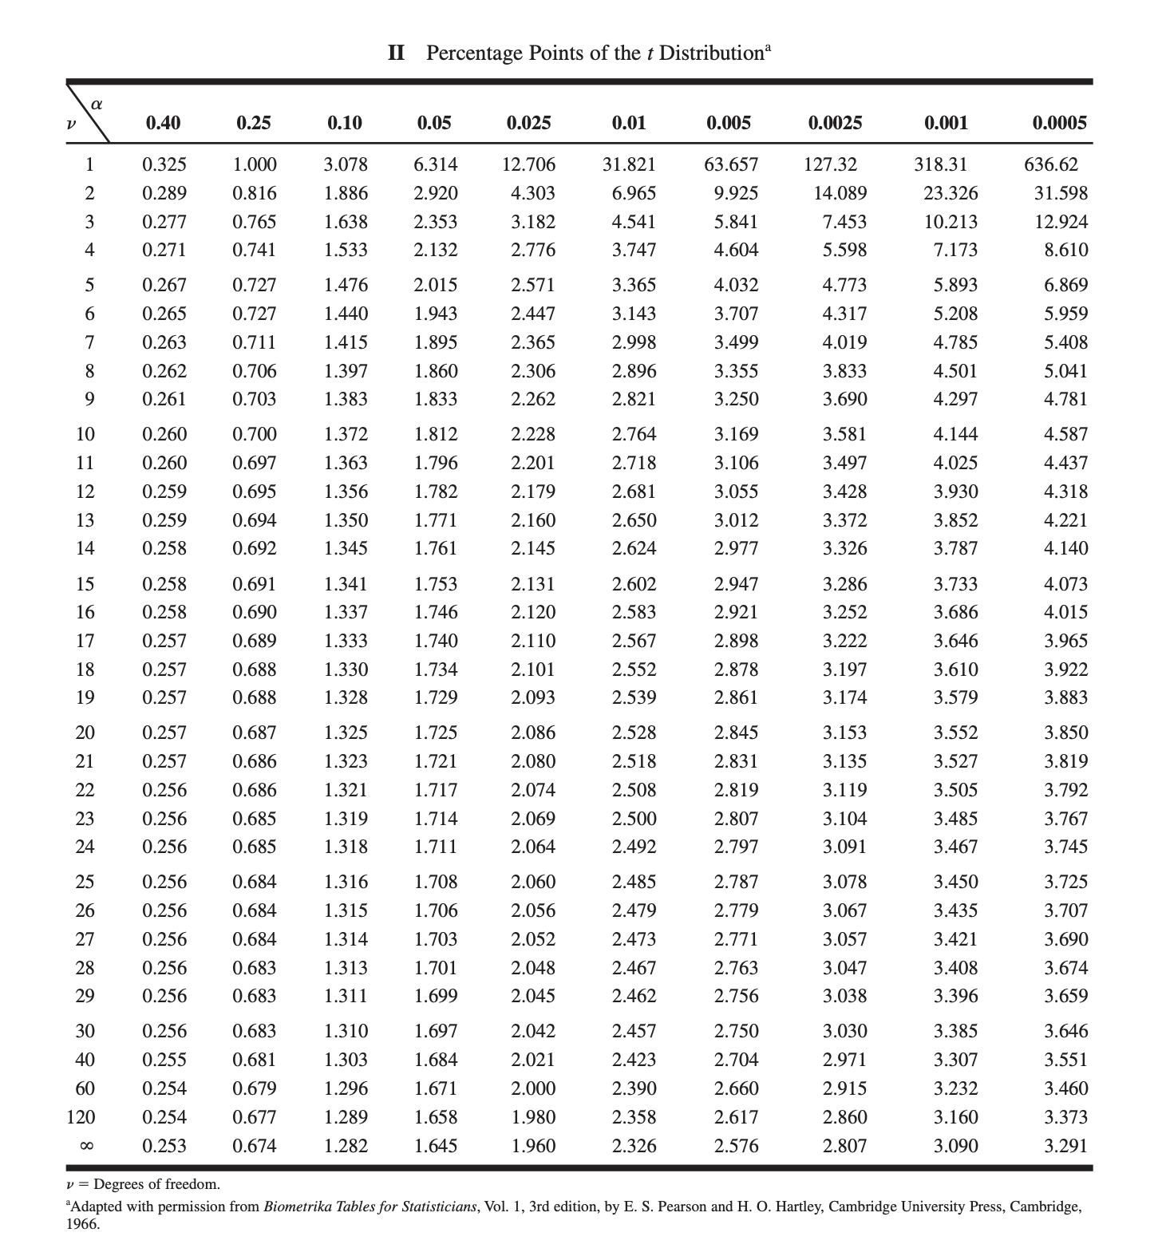

Slide 29
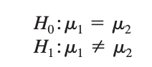
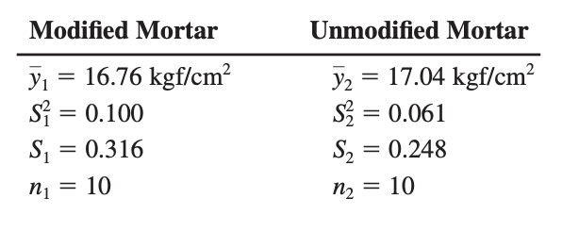
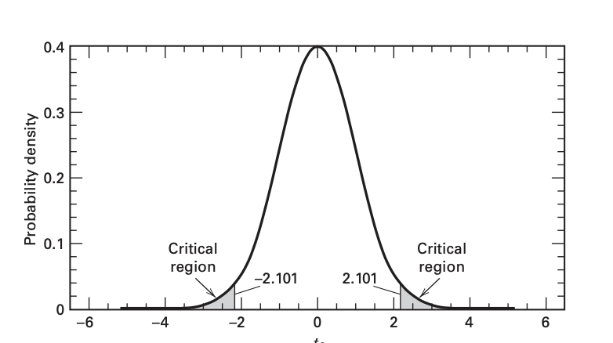
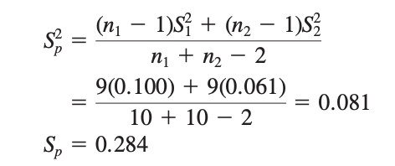
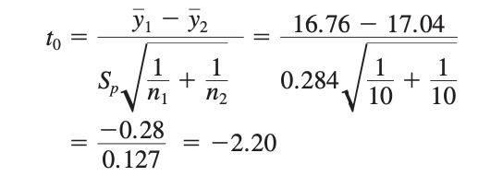
Simple Comparative Experiments: Concepts & Ideas
Hence, with n₁ + n₂ - 2 = 18, and if we choose 𝞪 = 0.05, then we would reject H₀ : 𝞵1 = 𝞵2 if the numerical value of the test statistic t₀ > t_{0.025,18} = 2.101, or if t₀ < -t_{0.025,18} = -2.101.

Slide 30
Simple Comparative Experiments: Concepts & Ideas
Recap:
Because t₀ = -2.20 less than, -t_{0.025,18} = -2.101, we would reject H₀ and conclude that the mean tension bond strengths of the two formulations of Portland cement mortar are different. This is a potentially important engineering finding.
The change in mortar formulation had the desired effect of reducing the cure time, but there is evidence that the change also affected the tension bond strength.
One can conclude that the modified formulation reduces the bond strength
If the reduction in mean bond strength is of practical importance (or has engineering significance in addition to statistical significance) then more development work and further experimentation will likely be required.
Simple Comparative Experiments: Concepts & Ideas

Slide 31

Questions?

Slide 32

Simple Comparative Experiments: Concepts & Ideas
Example:
If this example were to be considered for a casino, the casino would use the expected value to set the cost for a player to play the game. With an expected value of $3.50 for the die game, setting a value to play below $3.50 would create a loss as the game operates over time. Setting the value above $3.50 would result in a profit over time. A casino patron who knows the expected value would determine whether or not to play the new game based on the cost to play. A patron would be less likely to play this new game as the cost to play increases beyond the expected value of $3.50. Simply put, a player would be more likely to try this game if the cost to play were $4 than if the cost to play were $5.

Slide 33

Simple Comparative Experiments: Concepts & Ideas
Example:

